Slide 1
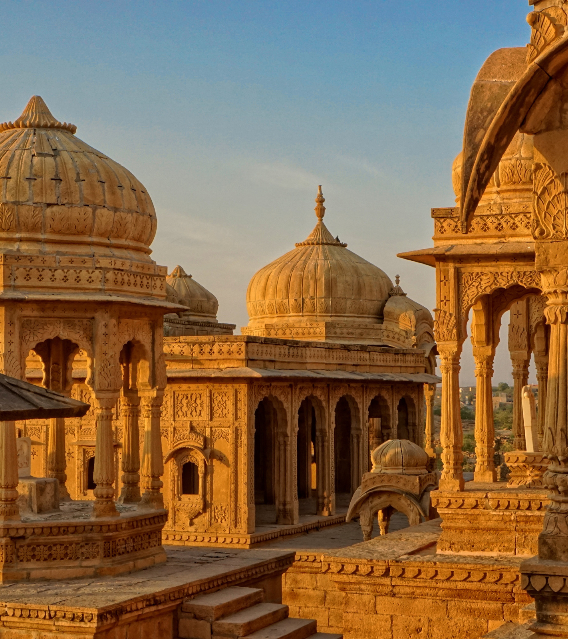
THE GOLDEN AGE
OF THE TAMIL EMPIRE
The Chola Dynasty - an insight.
Next Slide
Adam Drai - NYUAD

Slide 2
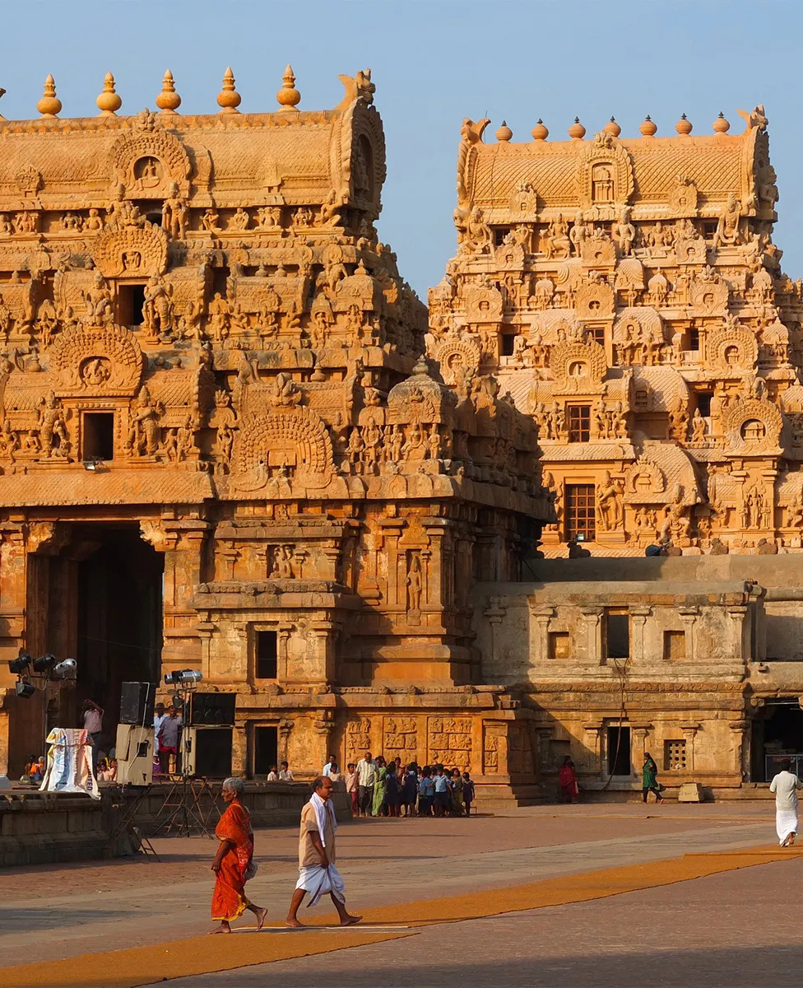
Introduction
The Chola dynasty was a Tamil dynasty originating from Southern India. At its height, it ruled over the Chola Empire, considered the golden age of the Tamil empire . The earliest datable references to the Chola are from inscriptions dated to the 3rd century BCE during the reign of Ashoka of the Maurya Empire.
The Chola empire was at its peak and achieved imperialism under the Medieval Cholas in the mid-9th century CE.
Next Slide

Slide 3
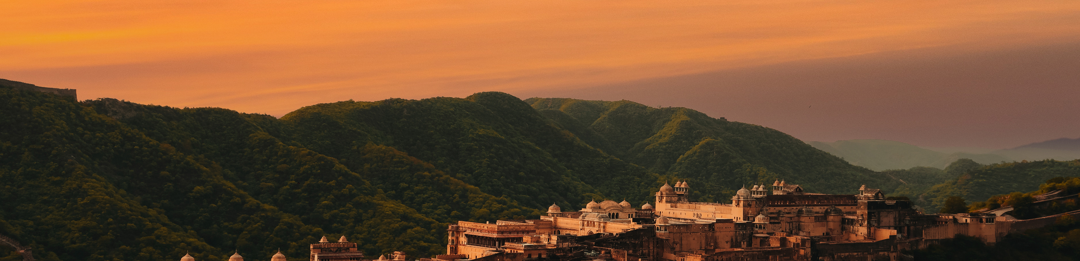
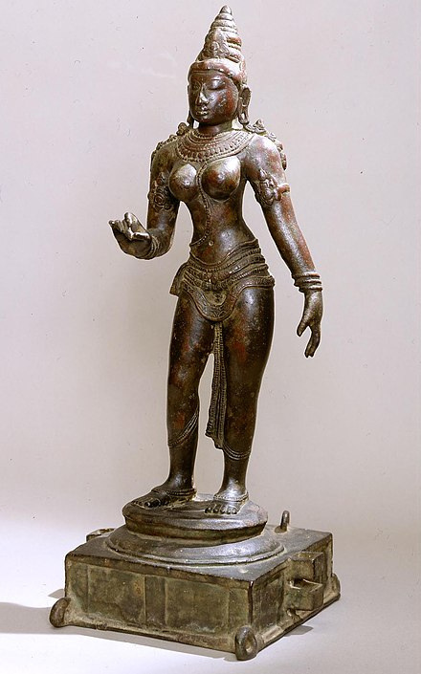
Imperial Chola
A Golden Age
THE SIGNIFICANCE OF LITERATURE
THE SIGNIFICANCE OF LITERATURE
Deep works of philosophy and grammar such as Commentaries on the great text Tolkāppiyam which dealt with grammar and ethics of warfare.
Periapuranam was another remarkable literary piece of this period. This work is in a sense a national epic of the Tamil people because it treats the lives of the saints who lived in all parts of Tamil Nadu and belonged to all classes of society, men and women, high and low, educated and uneducated.
At its height, the Chola empire thrived in its works of literature. Chola records cite many works, including the Rajarajesvara Natakam, Viranukkaviyamand Kannivana Puranam.
Next Slide

Slide 4
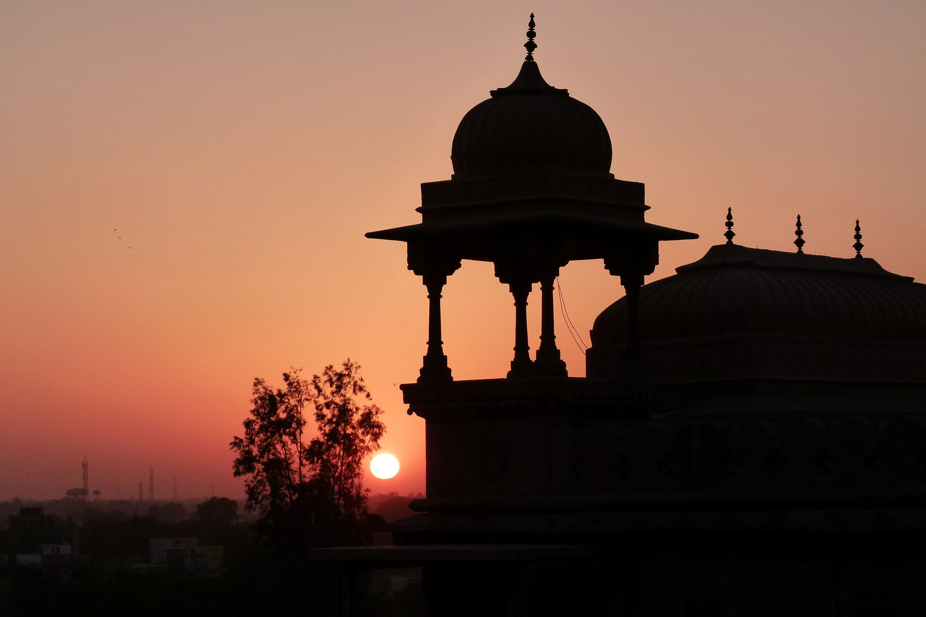
Thank You
Adam Drai
NYUAD

